Slide 1




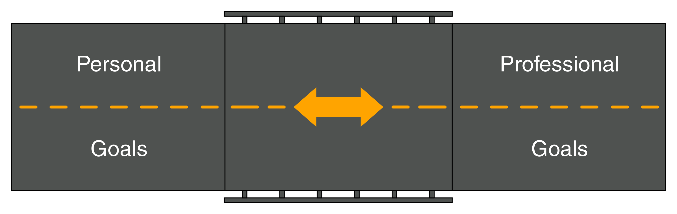

Life Skills for College & Career Goals
Based on the Guiding Principles For Success (GPS) Map Book
Six Lessons • 125+ Editable Slides • Reinforcement Activities
Interactive Worksheets • Knowledge & Skills Assessment
Engaging Visuals • Speaker Notes • Audio
Empower your learners to drive toward
their goals!
Lester Frederick, MBA, Ed.D
Notes:
Welcome to the Life Skills for College & Career Goals course.

Slide 2

Copyright
Copyright © 2026 by Lester Frederick
Cover design copyright © 2026 by Lester Frederick
Downloadable GPS Map Worksheets copyright © 2025 by Lester Frederick
Liability and Responsibility
The author and publisher will not be held liable for any direct or indirect damages, or financial losses resulting from the use of information in this slide deck.
Copyright Notice
All rights are reserved. This work is intended for personal and educational use only. No part of this book or the downloadable worksheets may
be reproduced, transmitted, modified, sold, quoted, paraphrased or distributed in any form, electronic, mechanical, photocopying, recording
or otherwise, without written permission from the publisher.
Disclaimer
This resource is provided for entertainment and educational purposes only. Every effort has been made to ensure accuracy at the time of publication, but no warranty is made, either express or implied. Readers should consult qualified professionals before using any techniques related to legal, financial, personal, business or other matters. The author and publisher are not responsible for any errors, inaccuracies or consequences of using this information. By reading this book the reader agrees to release the author and publisher from liability for any direct or indirect losses related
to errors, omissions or reliance on the content.
Fictional Disclosure
Names, characters, businesses, places, events, locales and incidents are either in the public domain, included under fair use or are products of the author’s imagination and are used fictitiously.

Slide 3
About The Author
ABOUT THE AUTHOR
As a rebellious boy, Lester skipped classes, found school boring, and did just enough to pass. He failed to graduate on time and had to repeat his senior year, where a required book he reluctantly read sparked a reading addiction at seventeen. He graduated but didn't believe he was smart enough for college. Around then he discovered the spiritual, business, and self-help books that changed his life.
Dr. Lester Frederick, also known as ‘The Synthesiza’, is the founder of Instructional Design and Leadership Development (IDLD) Creatives LLC, where he works as a Learning Experience Designer, Digital Project Manager, and Learning and Development Consultant. He is also the coauthor of the “Managing Creative Projects” chapter in The Fast Forward MBA in Project Management book.
From 2010 to 2016, Lester served as a university Leadership Course Director (BA). Since 2016, he has been a Project and Team Management Course Director (MA).
For over 25 years, he has intermittently refined his mashup of guiding principles for success. In 2025, his eclectic version was published in the book Guiding Principles For Success (GPS) Map. This course is based on the book.
https://idldcreatives.com/

Slide 4
Instructor's Guide
Several examples and illustrations can be expanded into case studies, discussions, or other learning activities.
The best learning experience for you and your learners is to acquire the companion eBook or paperback, but it’s not required.
Instructors may access and share the copyrighted interactive worksheet solely with participants to complete the activities.
GPS Map Link.
Participants will use an interactive worksheet/infographic to create their own Guiding Principles for Success (GPS) Map.
For the purposes of this course, personal life goals are integrated with college or learning goals, and professional work goals are connected to career goals.
This course can be taught in as little as two weeks or extended up to eight weeks.
It is recommended that you cover the material, including the writing exercises, in class first. Then assign the homework
and reading assignments as reinforcement activities.
This course is fully editable, including the speaker notes; however, instructors are encouraged to stay true to its original intent and meaning.
Encourage participants to connect course concepts to their personal, academic, and professional experiences.
Allow time for reflection and discussion to reinforce learning and self-awareness.
Notes:
Instructor’s Guide

Slide 5
Life Skills for College & Career Goals
Lester Frederick, MBA, Ed.D.
Notes:
Welcome to the Life Skills for College & Career Goals course.

Slide 6
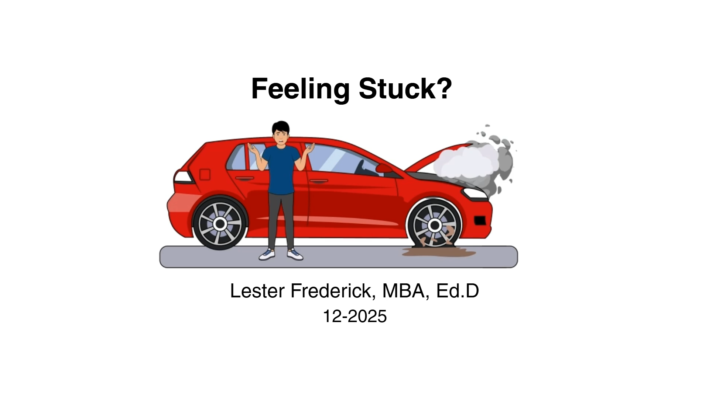
Life Skills for College & Career Goals
This course is based on the Guiding Principles for Success (GPS) Map book.
Life skills are skills for life, work, and school.
Notes:
This course is based on the Guiding Principles For Success (GPS) Map book. This animation is an overview of the book.

Slide 7

“Achieving work-life balance is not a one-time goal to check off, but an ongoing journey.” – Nathan Shaw
Destination Learning Outcome
Participants will create a GPS Map using an interactive infographic to bridge
their personal and professional goals, supporting a more balanced life.
Notes:
Read slide

Slide 8
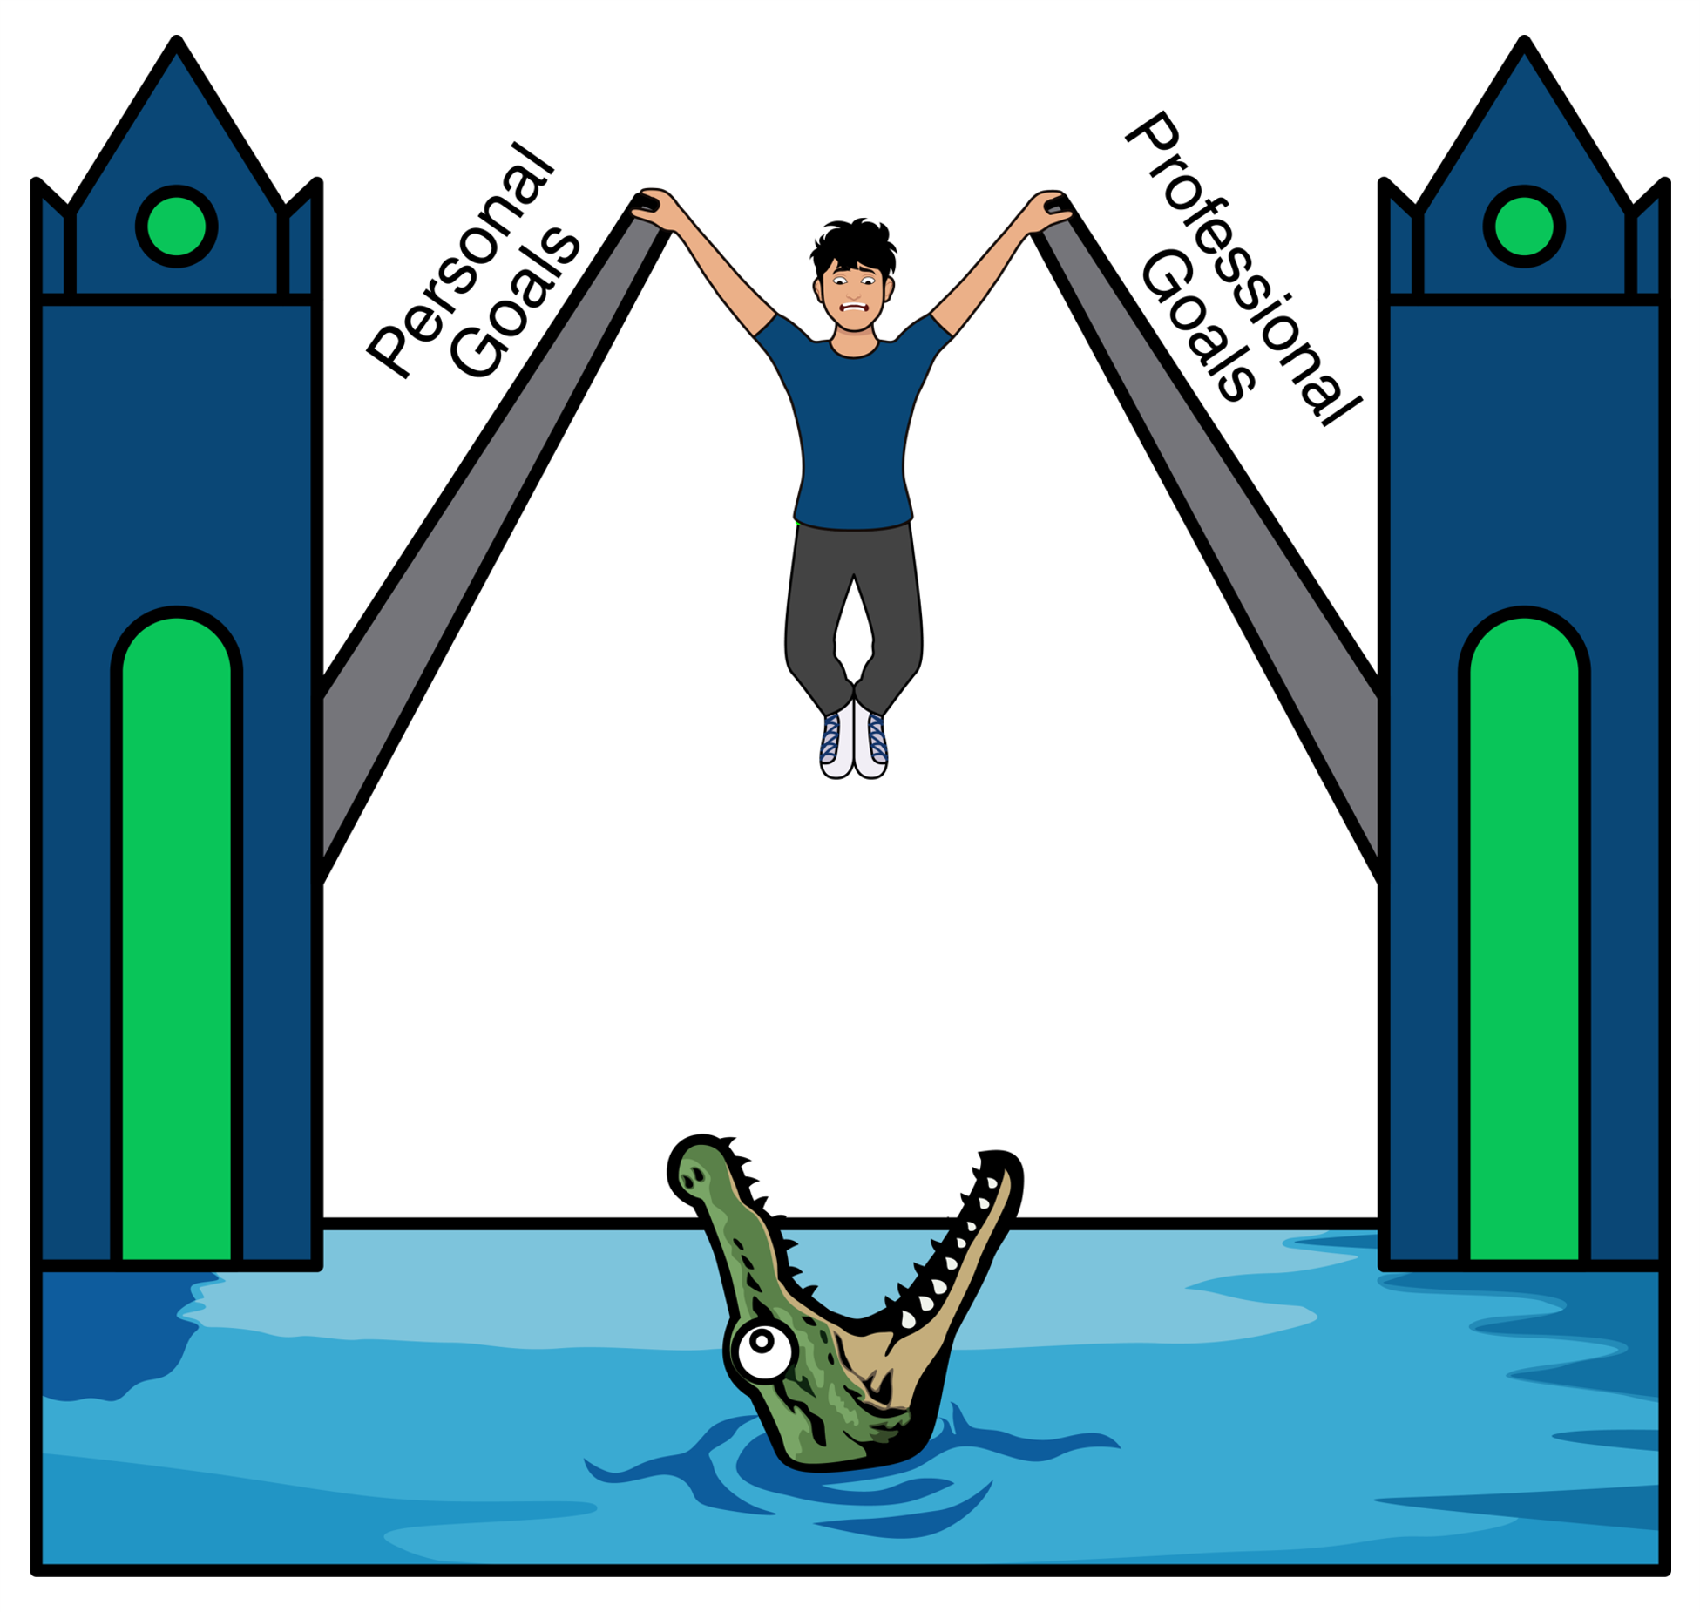
"Cultivate balance by achieving goals at work and home." – Dr. Travis G. Parry.
Introduction: Start Your Engine!
Notes:
Do you feel stuck? Many students and employees feel stuck, unsure of how to bridge the gap between their personal and professional goals. The goal is to help you cultivate balance between those goals. Your customized GPS Map can help you get from where you are to where you want to be.

Slide 9

Problem and Solution
Problem: Feeling stuck and out of balance between personal and professional goals.
Solution: Build a custom Guiding Principles for Success (GPS) Map to bridge this gap for progress.
Notes:
Read slide

Slide 10
Success is defined as bridging and achieving your personal life goals and professional work/school goals to create a fairly balanced life.
Defining Success
Notes:
There are many definitions for success. In the context of this course, Success is bridging and achieving your personal life goals and professional work goals to create a fairly balanced life. In this course, we integrate personal life goals with college or learning goals, and professional work goals with career goals. Think of success as a bridge stretching across a river. Personal goals (family, health, education) and professional goals (career, financial) are on two different sides. Managing a successful balance means actively deciding when to drive forward to one side and when to reverse to the other.

Slide 11

Driving Directions
You are the GPS Driver, not a passenger.
Keep an open mind on unfamiliar roads.
Answer questions now and refine them later.
Consistent application is beneficial, even if success isn't guaranteed.
Interactive worksheets are downloadable via the GPS Map book.
Worksheets are copyrighted for personal use only.
Notes:
These are your driving directions for the journey.
Read slide

Slide 12

Prompts For Your Guiding Principles For Success (GPS)
The six GPS prompts to assemble your GPS are:
Personality (Identity)
Purpose
Passion
Problem-Solving
Plan
Profit
Notes:
Read slide

Slide 13

Guiding Principles For Success (GPS) Explained
Guiding: Keeping your hands on the steering wheel to navigate.
Principles: Roads with signs and guardrails to maintain safety and focus.
Success: Using the GPS Map to bridge goals for a balanced life.
Notes:
Read slide

Slide 14

Describe, Assemble, and Practice (DAP)
We’ll DAP Each GPS
Describe: Understand each GPS prompt.
Assemble: Create each customized GPS.
Practice: Test-drive each GPS.
Notes:
Read slide

Slide 15

Personal Goals Introduction
One side of the work-life bridge represents your personal goals.
Three prompts for your personal GPS are: Personality (Identity), Purpose, and Passion.
School or work-life balance means bridging work and life, not totally separating them.
Notes:
Your Personal Goals are on one side of the work-life bridge. Your three prompts to create your personal Guiding Principles for Success are Personality (Identity), Purpose, and Plan. Once you have a clear understanding, or confirmation, of your personality (identity), it becomes easier to define your purpose and align it with your passion. Laying this foundation first can rev up your engine and get you moving on the road to a successful life.

Slide 16

"Know who you are. Accept who you are. Be who you are." – Anonymous.
Route 1: Personality (Identity)
Notes:
Read slide

Slide 17

"Without purpose, life is motion without meaning" – Rick Warren.
Route 2: Purpose
Notes:
"Without purpose, life is motion without meaning."

Slide 18

Description: Why Are You Here?
Why are you here on earth?
A car's purpose is to be driven; what is your purpose?
Notes:
A car's purpose is to be driven, but what's your purpose as a human being? Purpose is your reason for living in this world. It's important to determine your reason for existing before setting long-term goals that require significant commitment.

Slide 19
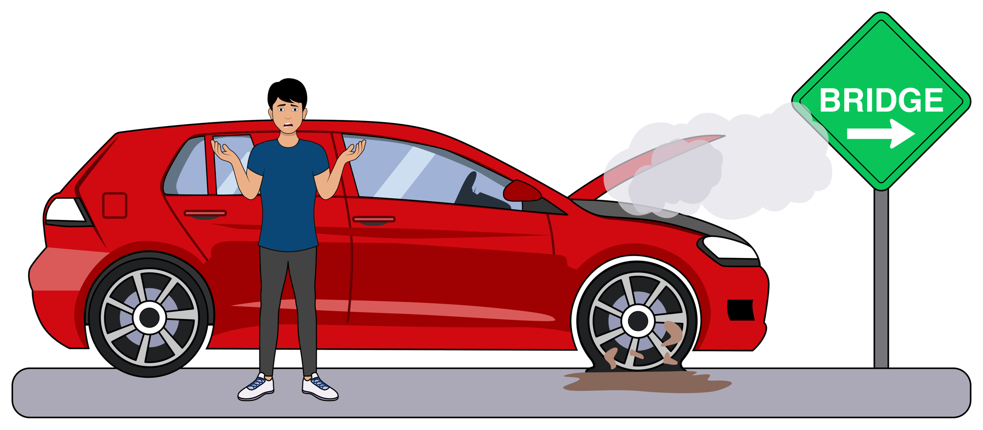
From Current Reality to Future Destiny
Purpose acts as your driving force and compass, guiding you forward.
Life can be like driving in Gran Turismo or Mario Kart—you may skid, but purpose gets you on track.
Notes:
Living without purpose is like spinning your wheels without making forward progress. Purpose answers critical questions, such as "Why are you here?" and "Where are you going?" When you know your 'why,' every task, from homework to career planning, gains significance and forward momentum.

Slide 20

Where Are You Going?
Knowing why and where you are helps determine where you want to be.
Combining identity with purpose improves psychological health (Murden, 2021).
Later, we’ll connect your personal purpose with your brand and professional purpose (Simon Sinek).
Notes:
Your direction becomes clearer when there’s alignment with who you are and what matters most to you. A meaningful destination is easier to pursue when it reflects both your personal values and your sense of purpose.

Slide 21

Ikigai: The Reason You Get Up in the Morning
Ikigai: Japanese term for a fulfilling life.
Integrates purpose, passion, talents, and societal contributions.
Notes:
Ikigai promotes a harmonious relationship between personal passions and professional goals. It is the idea that true fulfillment comes from doing what you love, what you're good at, what the world needs, and what you can be paid for.

Slide 22

The Hero’s Journey: A Framework for Purpose and Growth
The Hero’s Journey by Joseph Campbell is a framework of growth through challenges.
Seen in Star Wars, The Lord of the Rings, The Lion King, The Alchemist, and the Hobbit.
Figure 2.1
Notes:
Star Wars: Luke Skywalker grows from a farm boy into a hero by accepting his calling and confronting powerful forces. The Lord of the Rings: Frodo’s journey shows how ordinary individuals can develop courage and resilience through extraordinary challenges. The Lion King: Simba must confront his past and reclaim his identity before fulfilling his purpose. The Alchemist: Santiago’s journey emphasizes pursuing a dream and learning from the challenges along the way. The Hobbit: Bilbo discovers courage and capabilities he never knew he possessed through an unexpected adventure.

Slide 23
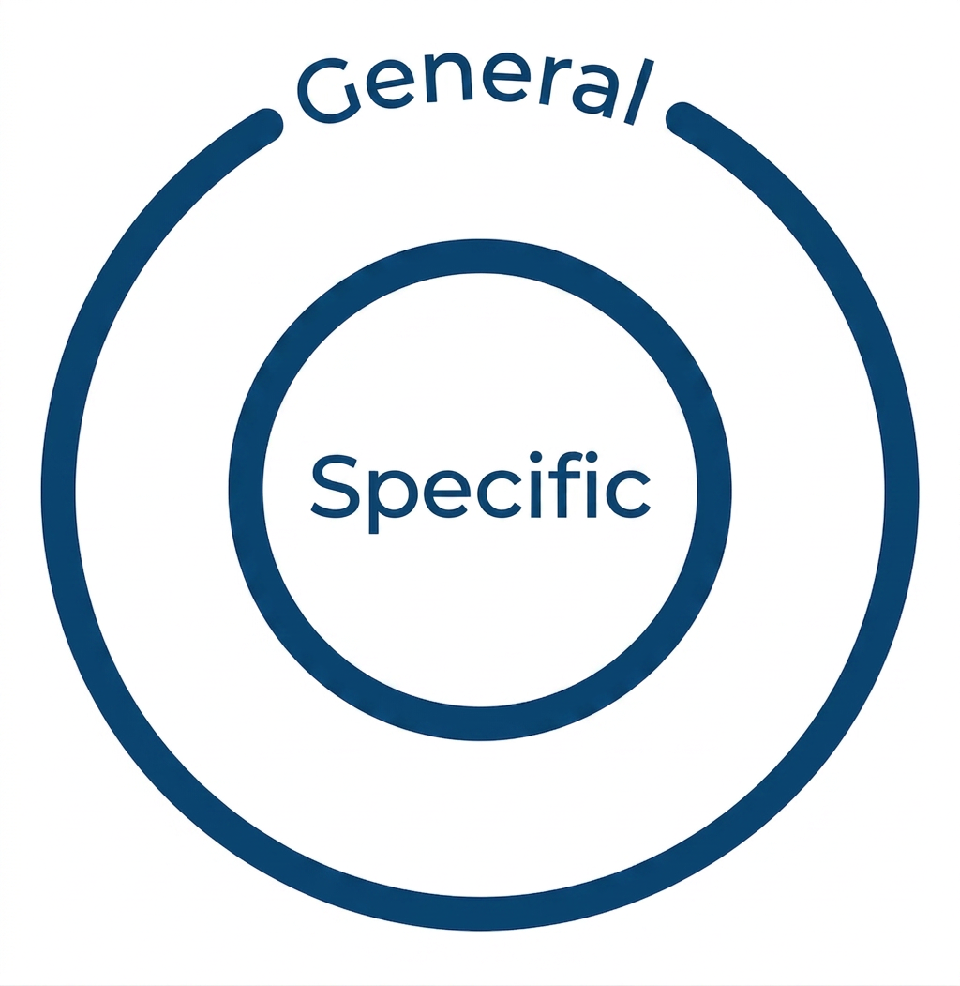
General vs. Specific Purpose
General purpose: Overarching life umbrella (e.g., appreciating life).
Specific purpose: A focused cause or calling (e.g., Joe Gardner in movie Soul - playing music).
Notes:
In the movie Soul, the character Joe Gardner believed his purpose in life was to play music. But it's important not to panic if your specific purpose isn't immediately clear. Often, purpose becomes clearer once you begin moving forward and exploring different paths.

Slide 24

Finding Purpose Beyond Achievement
Discovering your true purpose can take time.
U2’s song, I Still Haven’t Found What I’m Looking For, explores purpose and the meaning of life.
Olympian, Michael Phelps used The Purpose Driven Life book to help find his purpose.
Notes:
Michael Phelps is the world's most decorated Olympian. However, even with more than a dozen gold medals to his name, he still felt like something was missing. The book A Purpose Driven Life helped him to find his purpose.

Slide 25

The Transformative Power of Self-Expression
Self-expression, such as journaling, can help to uncover your purpose.
Example: Freedom Writers, a movie based on a true story of student empowerment.
Notes:
Freedom Writers is based on the true story of Erin Gruwell, a first-time teacher at a challenging inner-city high school who helped students realize their potential through self-expression and journal writing. Many became the first in their families to graduate.

Slide 26

Helping Others Can Make Your Life Make Sense
Your purpose is your reason for existing.
Purpose often emerges from serving a greater cause and solving problems.
Notes:
Gruwell discovered her purpose when she said, 'I finally realized what I'm supposed to be doing, and I love it. When I'm helping these kids make sense of their lives, everything about my life makes sense to me.'

Slide 27

Exploring Meaning and Purpose Through Roleplay
Simulation games like The Sims let players explore life choices and balance work-life dynamics.
Roleplay provides a safe space to experiment with different decisions, and life paths.
Notes:
The Sims encourages players to reflect on how they balance their personal life, and professional life. Using simulated environments can be a safe way to test out life paths.

Slide 28

Naruto: Purpose, Perseverance, and Significance
Anime and Manga series Naruto
Naruto grows through determination and mentorship.
Taking responsibility and overcoming challenges help him discover his purpose.
Consistent effort transforms Naruto from an outsider into a respected leader.
Notes:
The anime and manga series Naruto shows how purpose and significance develop over time. Naruto Uzumaki starts as an underdog but grows through hard work, mentorship, and friendships. By taking responsibility for his actions and persevering through challenges, he gradually discovers his purpose. Over time, his competence and dedication allow him to make a meaningful impact, becoming a hero who unites allies and former enemies. This story demonstrates how purpose, effort, and responsibility combine to create significance.

Slide 29

‘Goals Are Dreams with a Deadline’
Connect your purpose (your why) to your goals (your where).
“Begin with the end in mind [dream goal]" and work backward (Covey, 2020).
“To be successful and balanced, we should set goals in all areas of life” (Ngezahayo, 2022)
Notes:
To transition a dream into reality, it requires a target and a defined timeframe. Clearly define what you want to achieve and when you want to achieve it.

Slide 30

Structuring Success with SMART Goals
Utilize the SMART framework to set your goals (Figure 2.2).
Purpose is the "why"; Plan is the "how."
Notes:
When setting foundational school or career goals, ensure they meet all five SMART criteria. This structured approach maximizes the chance of turning intention into success.
Note: Page 44 – Figure 2.2 SMART Goal-Setting Framework

Slide 31
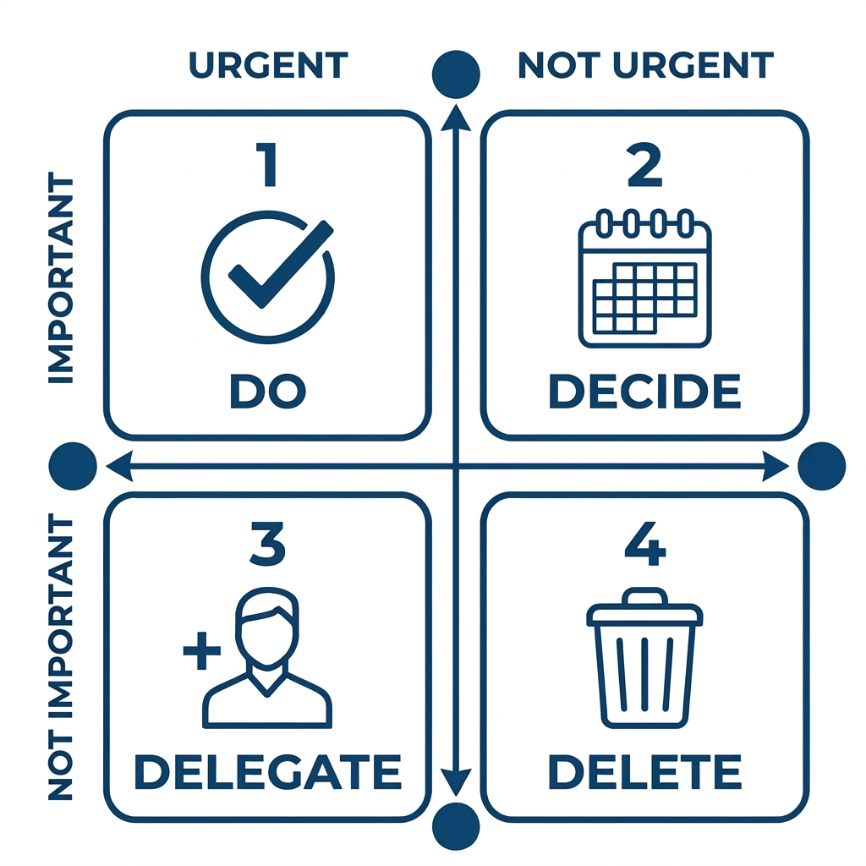
Connect Your Purpose, Goals, Priorities, and Time
The Eisenhower Matrix
Do urgent and important tasks now.
Decide when to do important, non-urgent tasks.
Delegate urgent, less important tasks.
Delete unimportant, non-urgent tasks.
Notes:
The Eisenhower Matrix helps us focus on what matters most. Effective time management is not about doing more—it is about investing our time in actions that move us closer to our goals. Examples - Do now: Pay a bill due today. Decide: Schedule weekly time for project work. Delegate: Ask a colleague to gather routine information. Delete: Stop habits that hinder your goals.

Slide 32

Instructions: Look in the Mirror Today
Assemble
Refer to the examples and follow the instructions in Chapter 2
Fill in your GPS Map.
Only one solid sentence for each question.
The answer to the third question will be your first goal.
Notes:
Read slide. Create your Purpose Guiding Principle. Focus on personal responses; professional purpose comes later. Avoid generic phrases, such as: "I want to live life to the fullest." Don't worry if your purpose is unclear now - you can refine it later. Keep each answer to one brief sentence. Your third answer will be your first foundational goal.

Slide 33
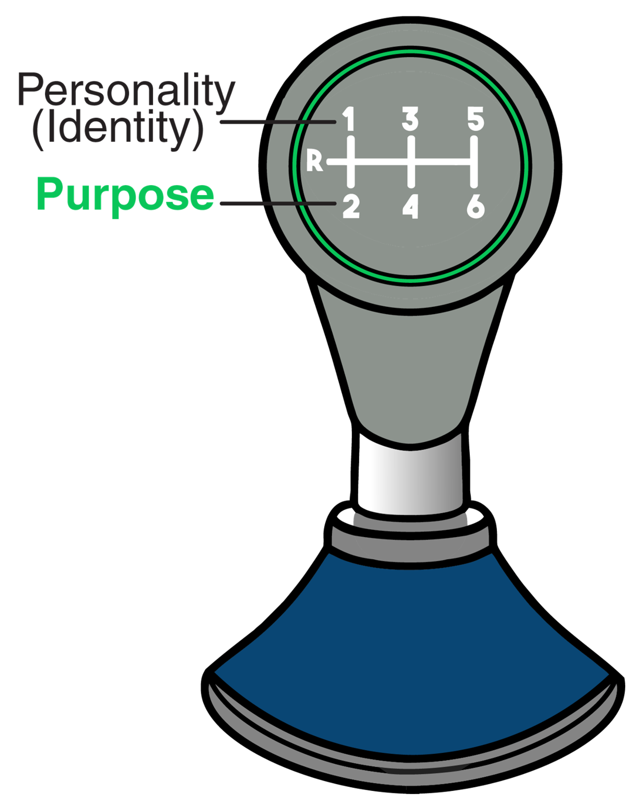
Homework: Practice and Reading Assignments
Read Chapter 2.
Refine your Purpose GPS.
Reinforce your GPS with the book’s suggestions.
Symbolically shift your Purpose GPS into second gear.
Notes:
Read slide.

Slide 34

Rest Stop 1: Personal Goals Summary
Reflect on your Personal GPS and Goals.
In part, you’ve listed who you are (identity), where you’re from (history), why you’re here (utility),
where you are now (reality), and where you want to be (destiny).
Now, you can create the steps for how to get there (strategy) by leveling up
to the Professional Goals of your GPS Map.
Notes:
Read slide

Slide 35

Professional Goals Introduction
Professional goals: The other side of the work-life bridge.
Built on Problem-solving, Planning, and Profit.
Create your own sustainable work-life balance.
Notes:
Read slide

Slide 36
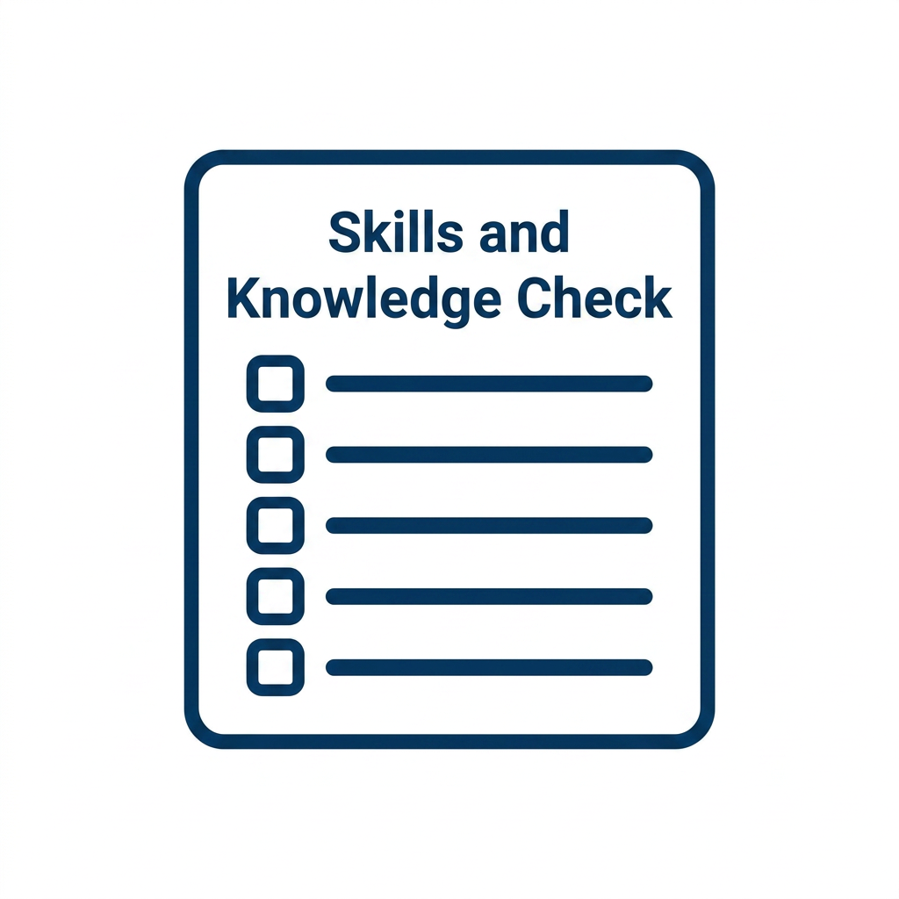
Skills and Knowledge Check
Turn to Chart A (p. 126)
Knowledge is what you know; skills are what you do.
Head (thinking) → Heart (feeling) → Hands (doing).
Answer the chart questions for SKAN development.
Notes:
(Page 126). Turn to and display Chart A. Skills and Knowledge Check Knowledge is knowing and skills are doing—both are necessary for SKAN development. The GPS process should move from your head, where thinking occurs, to your heart, where emotions are formed, and finally to your hands, where action is taken. The Skills and Knowledge Check is designed to consistently remind you to pursue your paired goals using your GPS Map.

Slide 37
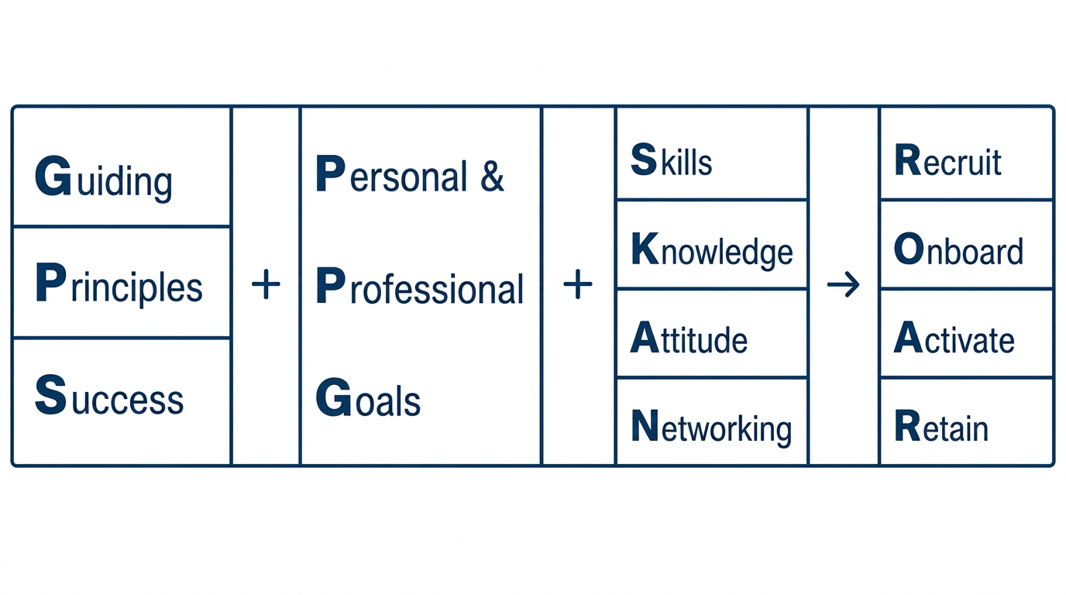
GPS + Goals ROAR Process
Graduates who align their GPS, Goals, and SKAN factors can better navigate the ROAR hiring process, creating mutual value for themselves, educators, employers, and HR trainers.

Slide 38
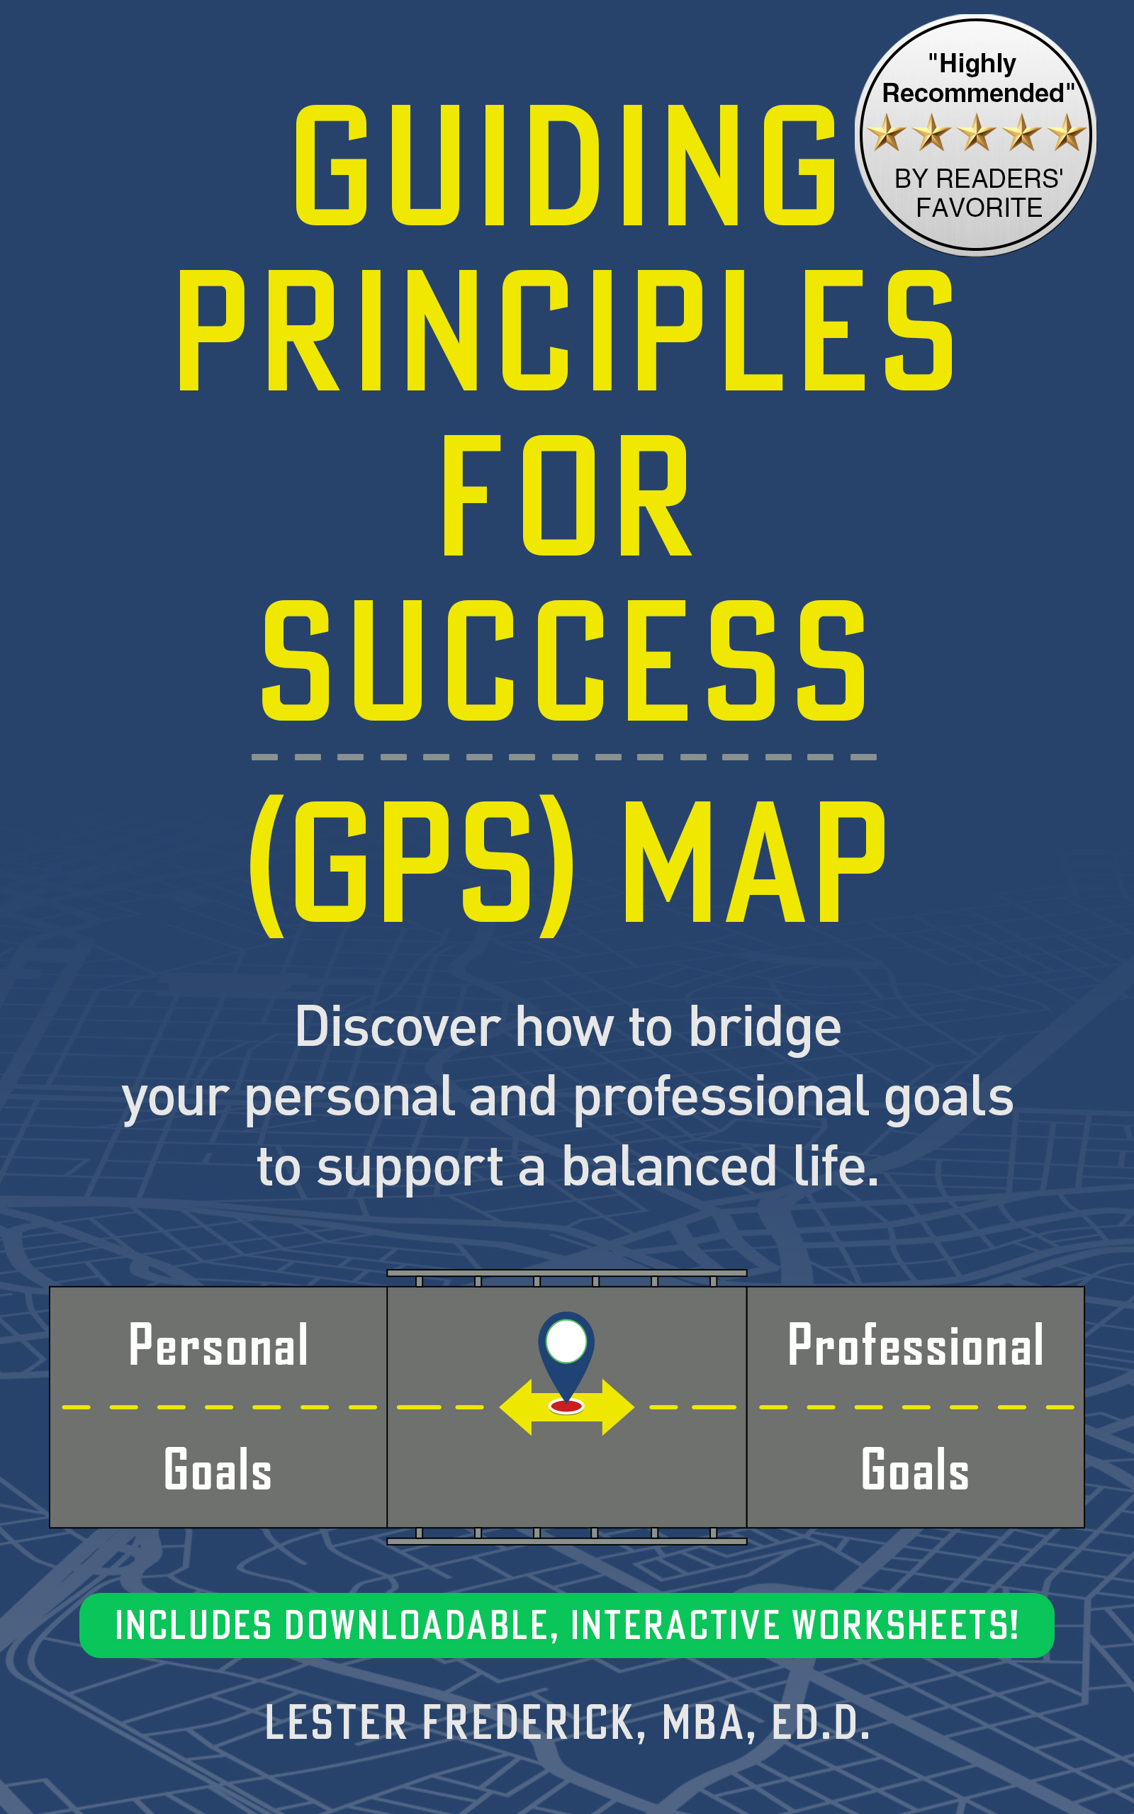
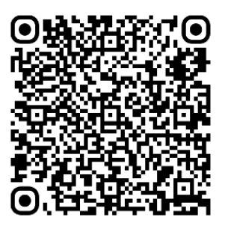
Guiding Principles For Success (GPS) Map

Slide 39
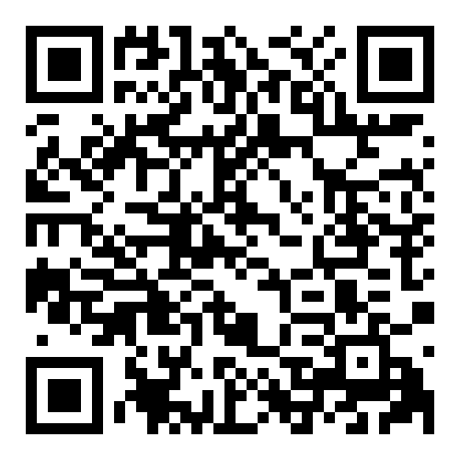
Review
Your words can help others
Please pause to scan the QR code to leave a brief and open review.
Or input this URL into your browser: https://bityl.co/Syb9
Notes:
Read slide.

Slide 40
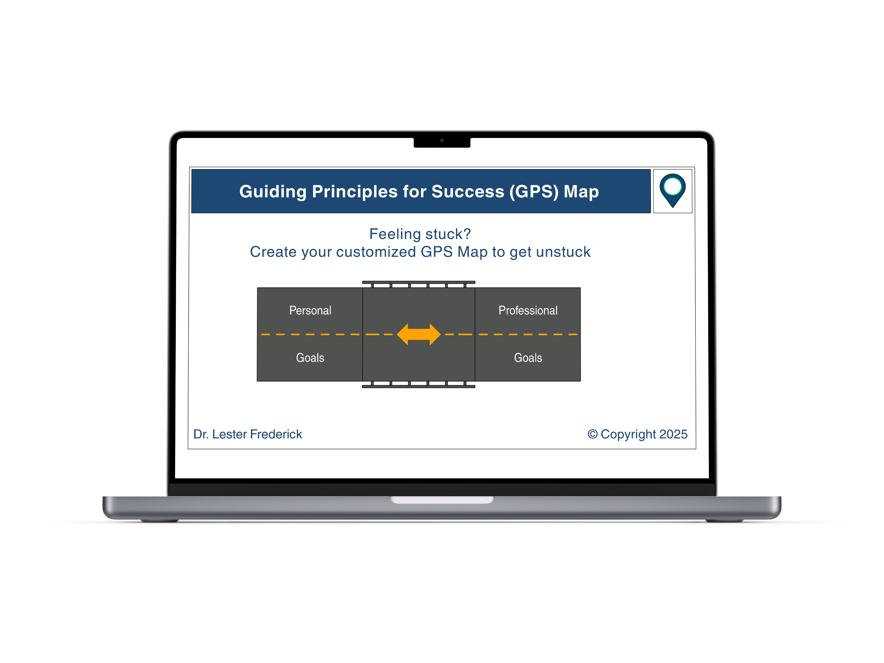
Interactive eLearning Experience
Test Drive Demo
Select or type the following into your browser to access: https://tinyurl.com/y962rdmv
Notes:
Take a test drive for a more immersive experience

Slide 41
References
Thanks for reviewing!
Please share it with others.
-Lester
info@idldcreatives.com
Store: https://idldcreatives.com/store/

